Slide 1
Database Projects in Visual Studio
Improving Reliability & Productivity

Slide 2
Overview
What problems are we trying to solve?
Why not Entity Framework?
Benefits of using Database Projects
Prerequisites / Requirements
Database Project Flow
Demo
Where to take it next
Acknowledgements / further reading

Slide 3
What problems are we trying to solve?
Good development code not being promoted into test and production databases
Bad development code being promoted into test and production databases
Too much effort
Bad schema
Stored procedures that won’t work
Logins/schemas that no longer exist but are required
Schema changes that have broken your database
Configuration data not being promoted
Tables / Schemas / Stored Procedures etc. not in source control

Slide 4
Why not Entity Framework?
Legacy systems – database already exists so code-first is not viable
Entity Framework might be difficult / impossible to implement at your site
EF performance issues

Slide 5
Benefits of Using Database Projects
Place your databases under source control
Easily migrate from development to testing to production – even automatically!
Compare schema and data before publishing
Eliminate stupid errors before they happen

Slide 6
Prerequisites / Requirements
Visual Studio 2012 +
SQL Server Data Tools (SSDT)
https://msdn.microsoft.com/en-us/library/mt204009.aspx
Download required for 2012
Integrated with VS after 2012
Existing SQL database (hopefully obvious)

Slide 7
Database Project Flow
Copied straight from Jason Kassay’s presentation:

Slide 8
Demo

Slide 9
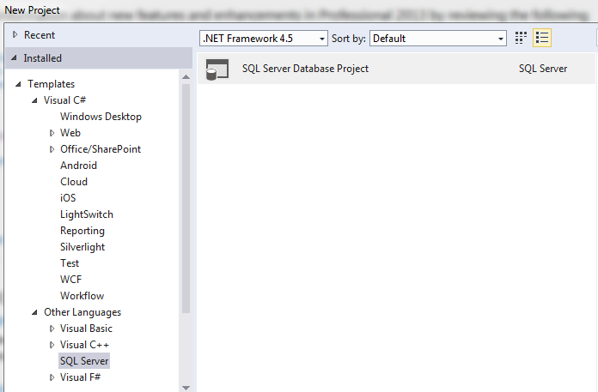
Step 1

Slide 10
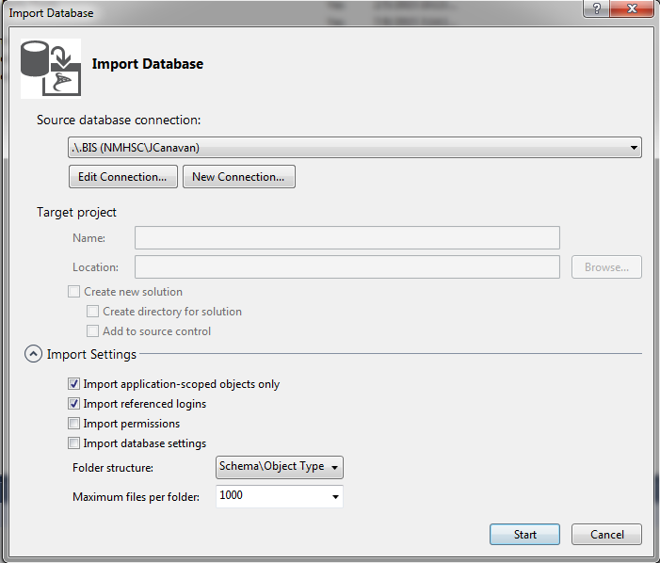
Step 2
Right-click solution, Import -> Database

Slide 11
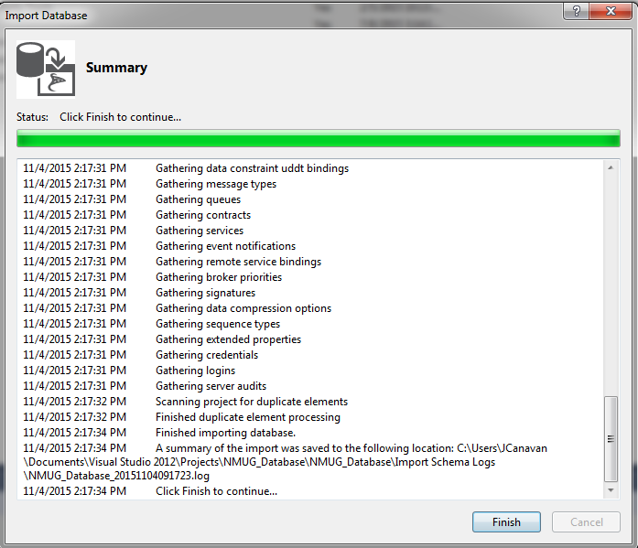
Step 3

Slide 12
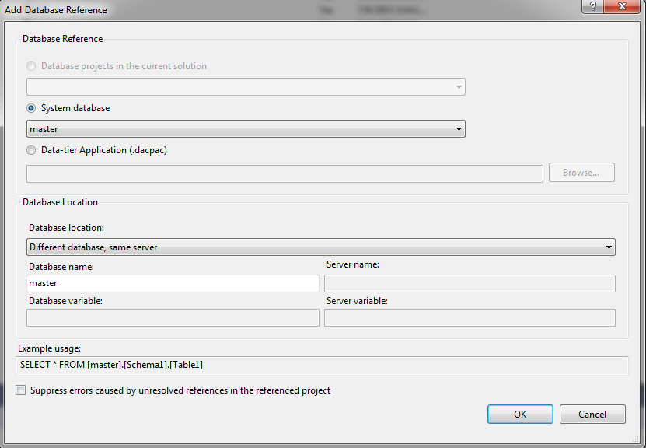
Step 4
My experience is that I have to add a reference to the Master database
Right-click solution -> Add -> Database Reference

Slide 13
Let’s actually use this
Tools -> SQL Server -> New Schema Comparison
Select the database as the source
Select the project as the target
Click on compare
If there are differences you can right-click to Include/Exclude as needed
If you want, Click the Update button to update your project
Schema comparisons can be saved and added to the project
In this way you can keep your project updated to the latest version of development
Don’t forget to rebuild whenever you update!

Slide 14
Let’s do something slightly more useful
How about using schema compare to migrate database changes?
You can set the source to either your development database or the project
You set the target to your staging/QA/team database
You can easily apply all of these changes just by clicking on the Update button
Click on the script icon to generate a script
Database changes are migrated

Slide 16
One final useful step
Tools -> SQL Server -> New Data Comparison
Choose your target and source databases
Select what type of comparison to run
Differences
Source only
Target only
Identical
I have used this when working with lookup tables and configuration tables

Slide 17
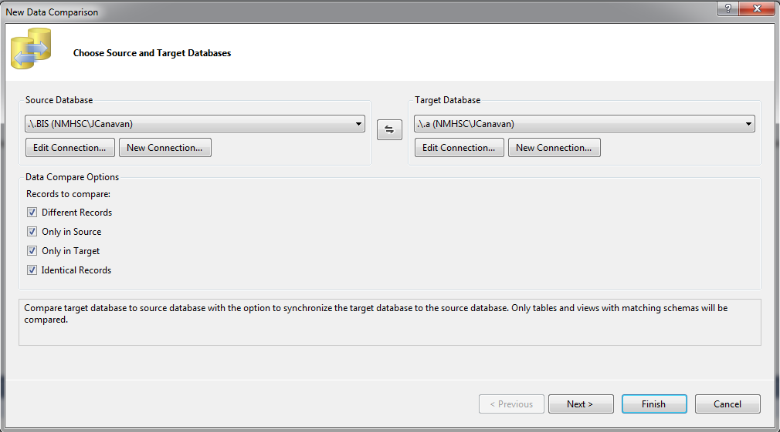

Slide 19
Where to take it next?
Automation
Deployment scripts
Publish https://msdn.microsoft.com/en-us/library/hh272687(v=vs.103).aspx
DACPAC https://msdn.microsoft.com/en-us/library/ee210546.aspx
SqlPackage.exe https://msdn.microsoft.com/en-us/library/hh550080(v=vs.103).aspx

Slide 20
Acknowledgements/Further Reading
Jason Kassay / Email: jkassay@gmail.com / Twitter: @jasonkassay /Blog: http://www.JasonKassay.com
Jason was the first person I’d seen use database projects. His presentation at SQL Saturday hinted at some of the problems that I could solve
SQL Server Data Tools (SSDT) https://msdn.microsoft.com/en-us/library/hh272686(v=vs.103).aspx

